Slide 1
TV / Movie Search App
Project 2
Ernest

Slide 2
Index.js
Home.js
Search.js
Contact.js
Carousel.js
Input.js
Results.js
Favourites.js
NavBar.js
App.js
Login.js
App Structure
Pages
Components

Slide 3
Key Features
Display (Carousel)
Upcoming Movies (in SG)
Top Movies of the week
Top TV Shows of the week
Search TV show/movie by name
Results
Synopsis
‘Find out more” button which takes users to TMDB’s site
“Add to Favourites” feature (Stretch Goal)

Slide 4
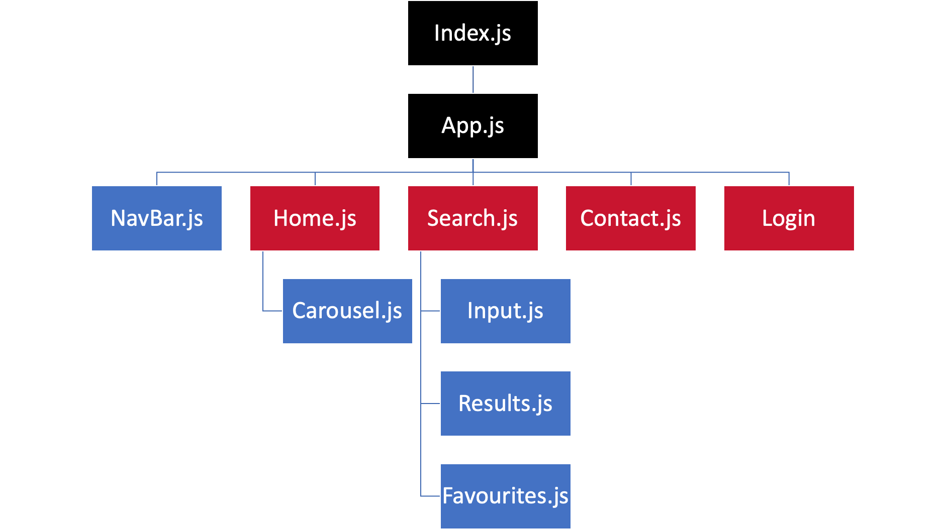
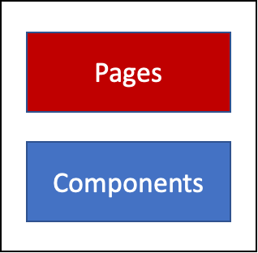
Home Page

Slide 5
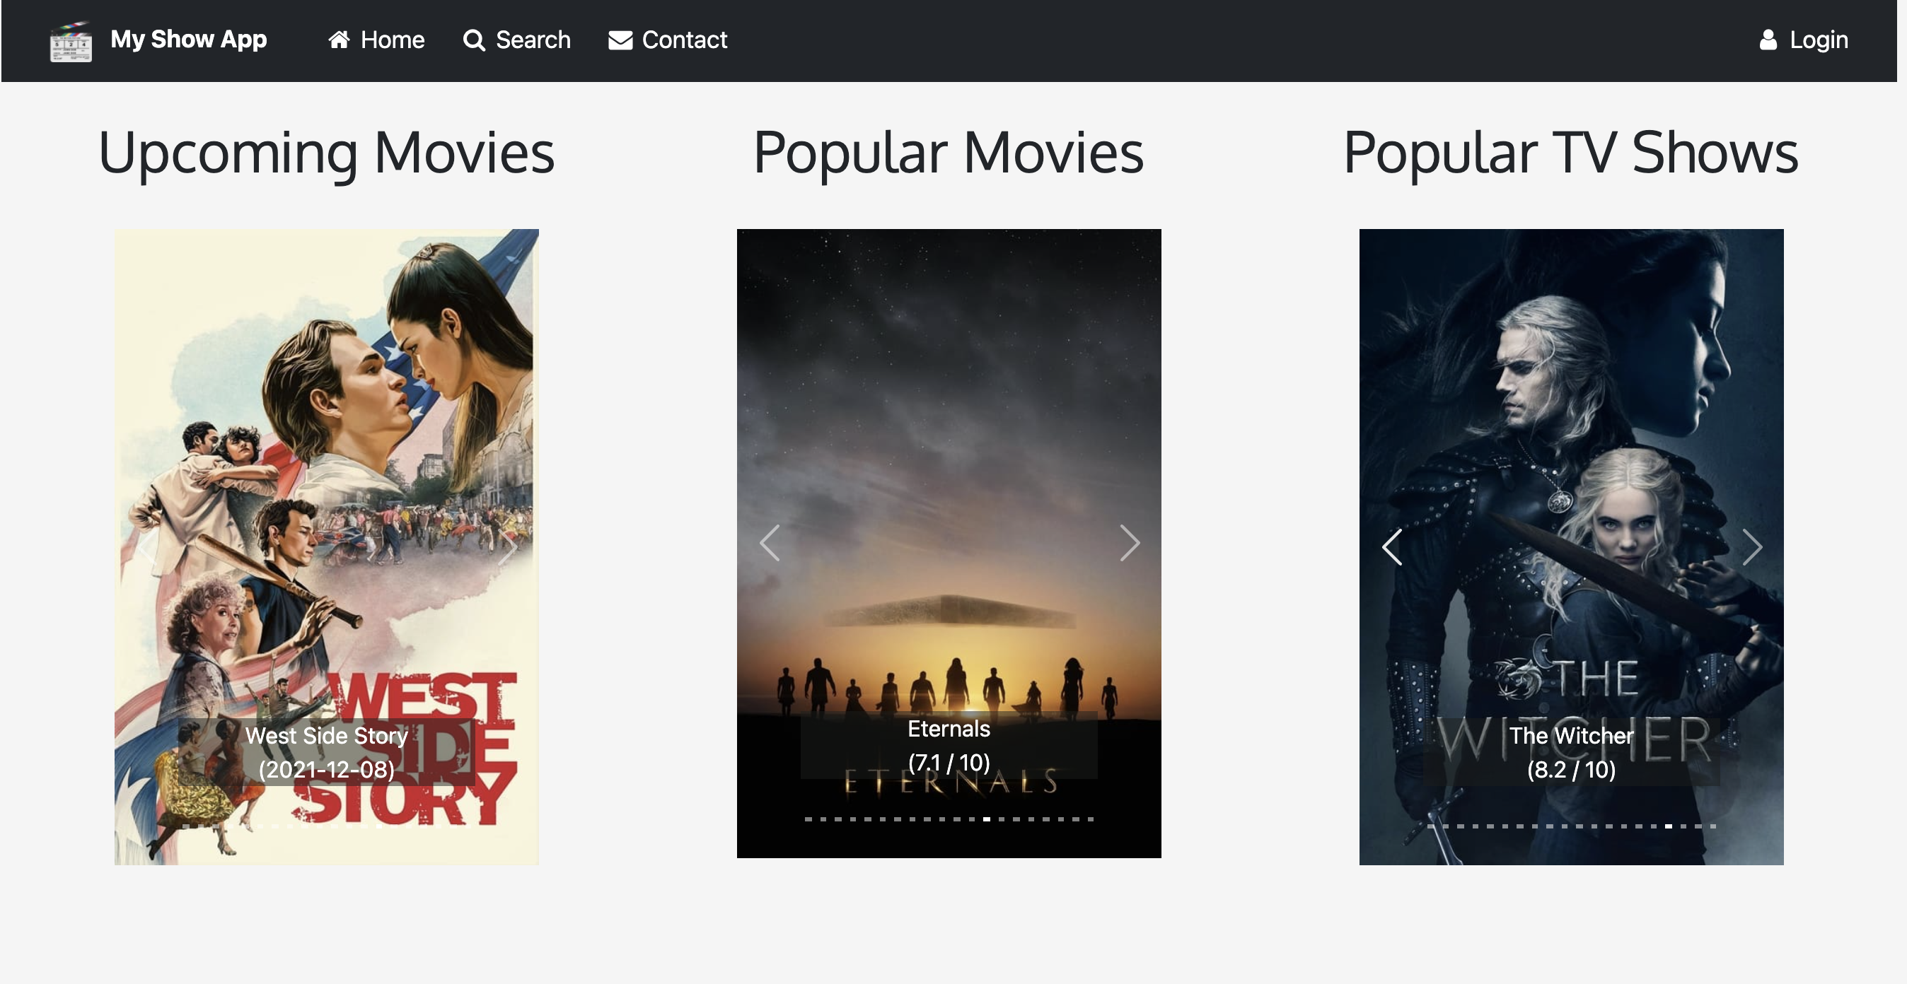

Slide 6
Search Page

Slide 7
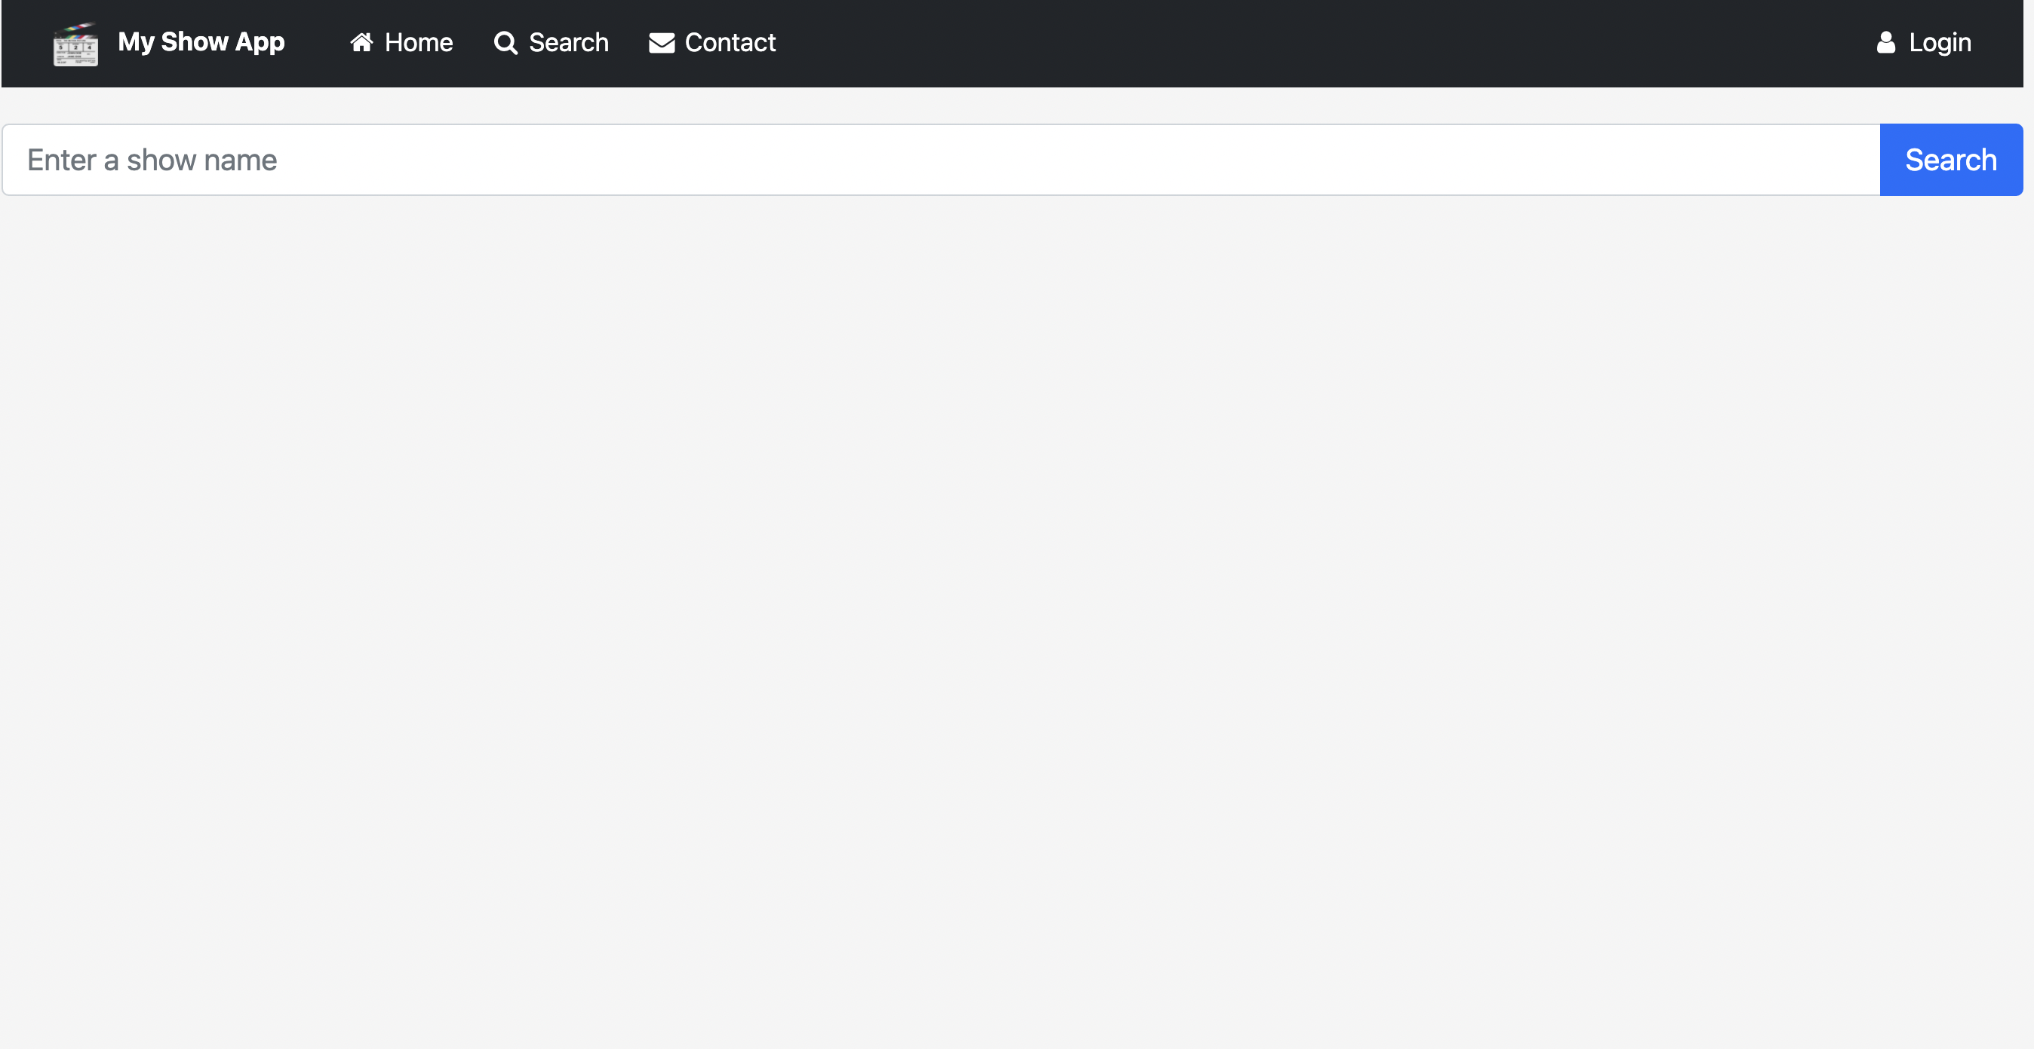
Search Page (Initial)
Input Field

Slide 8
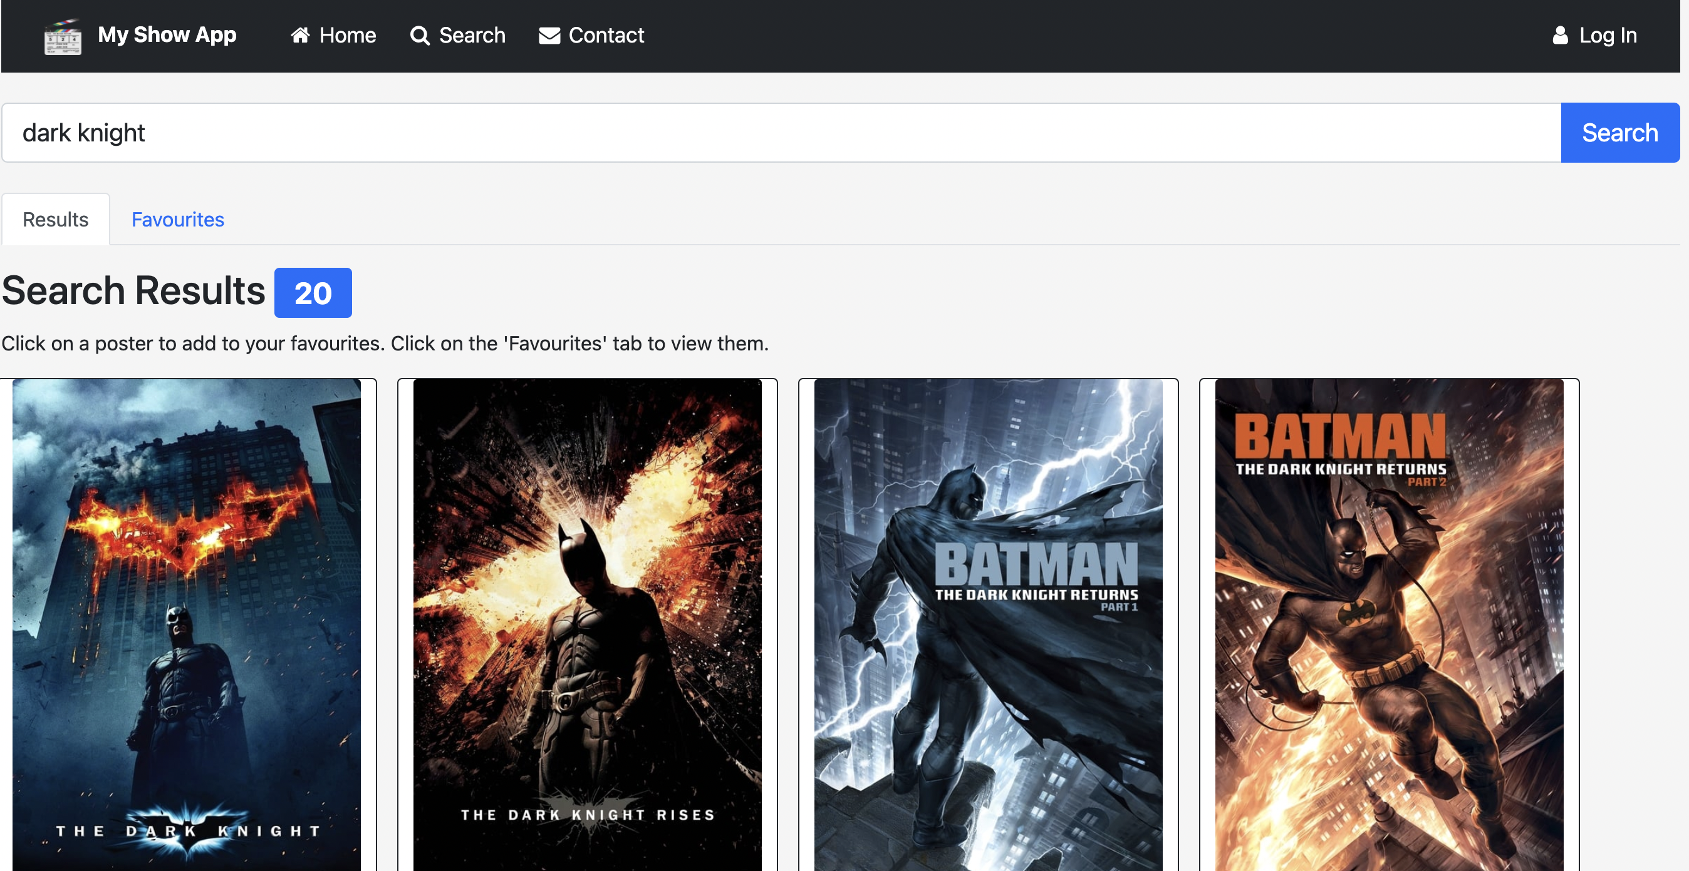
Search Page (First/Subsequent Search)
Results Tab

Slide 9
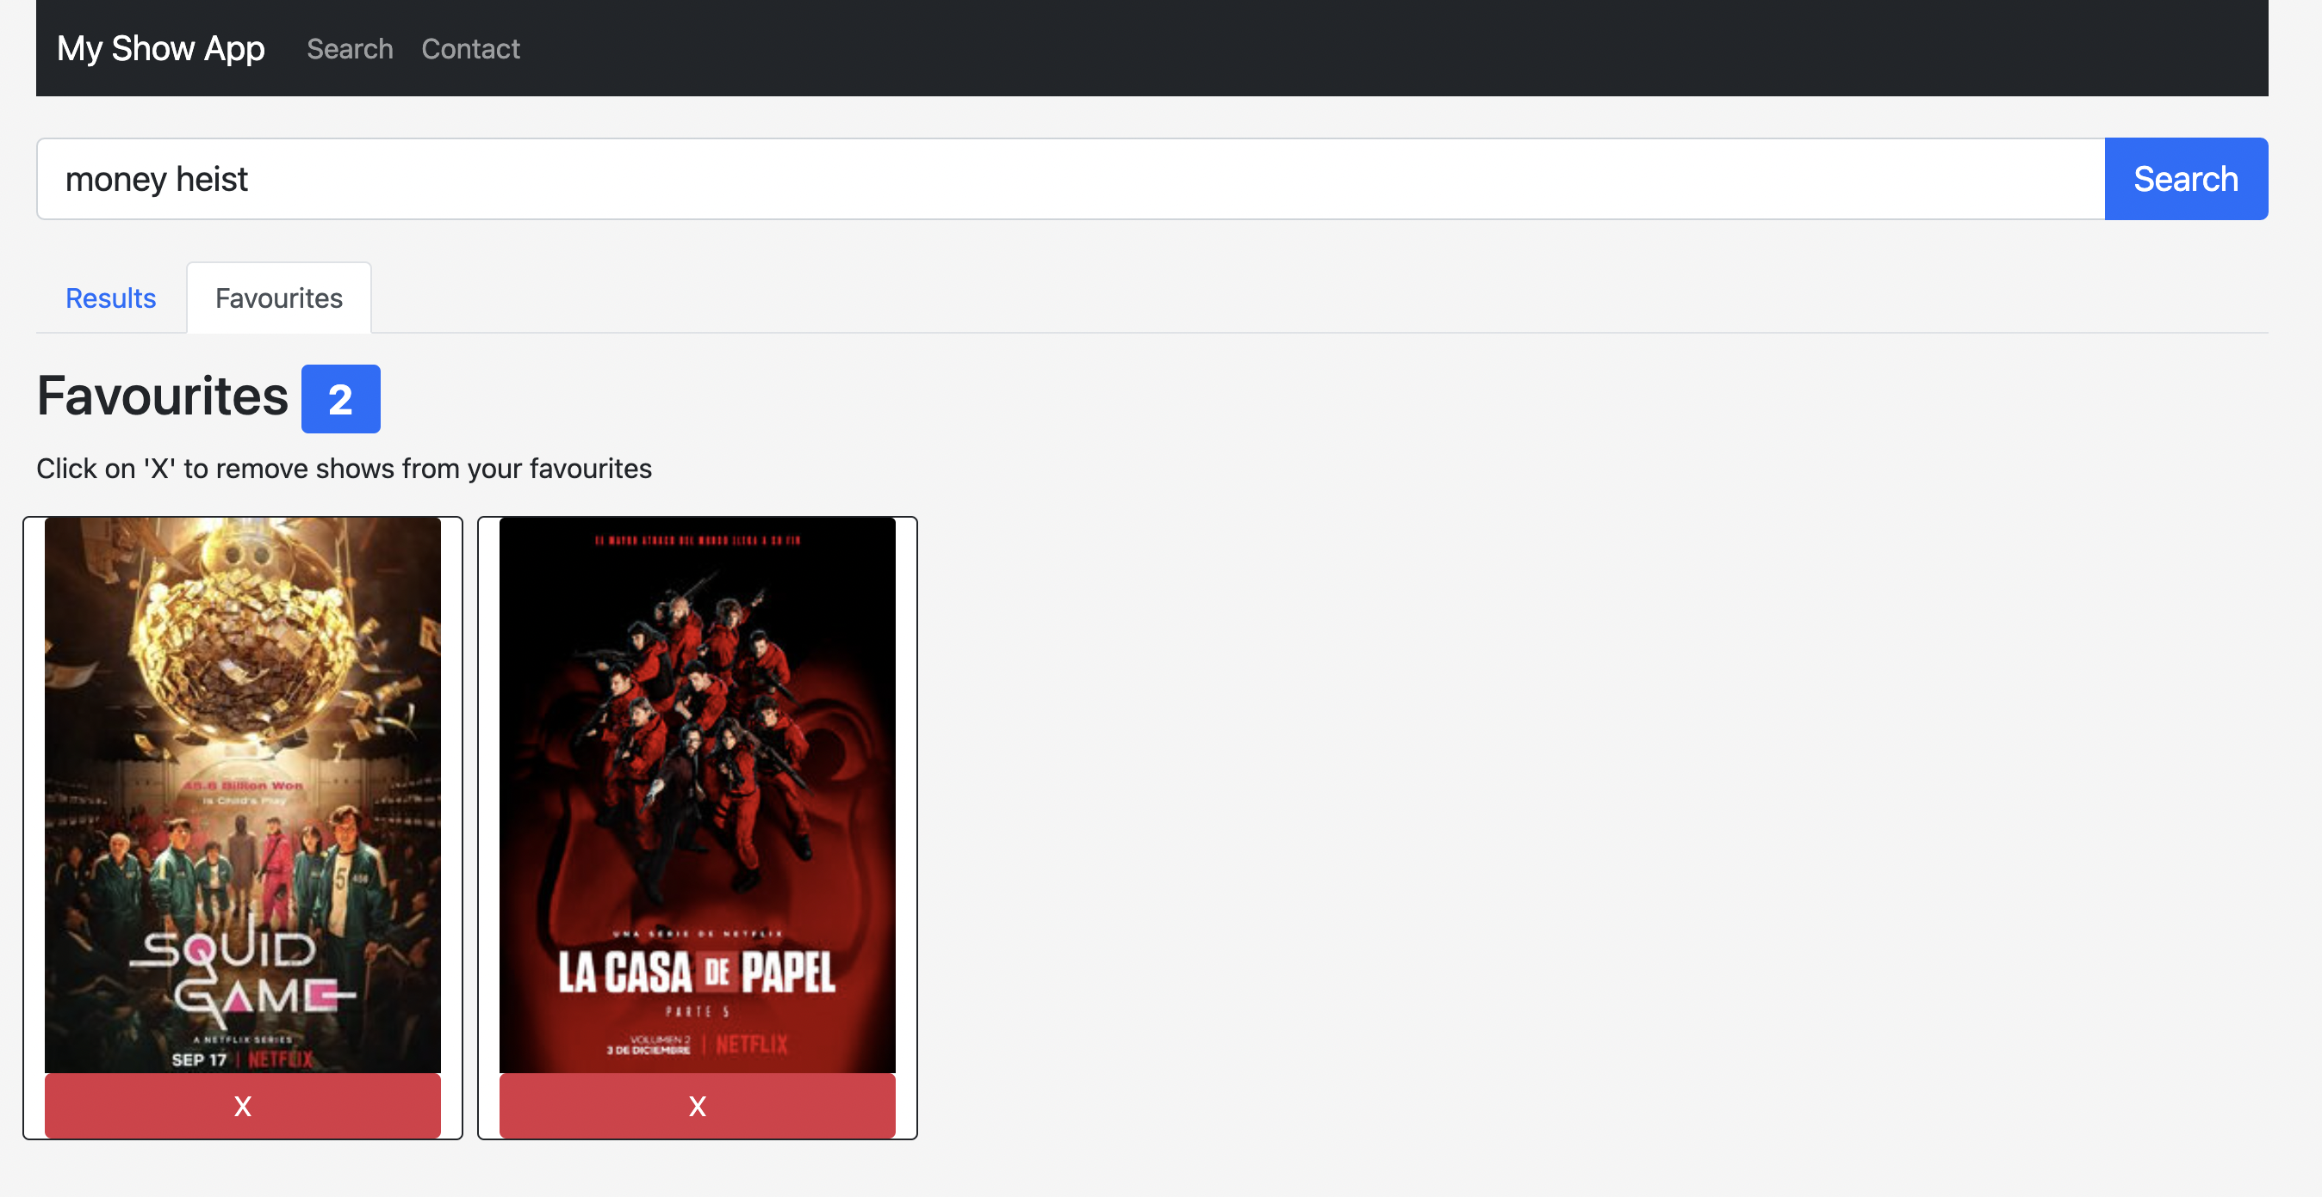
Search Page (First/Subsequent Search)
Favourites Tab

Slide 10
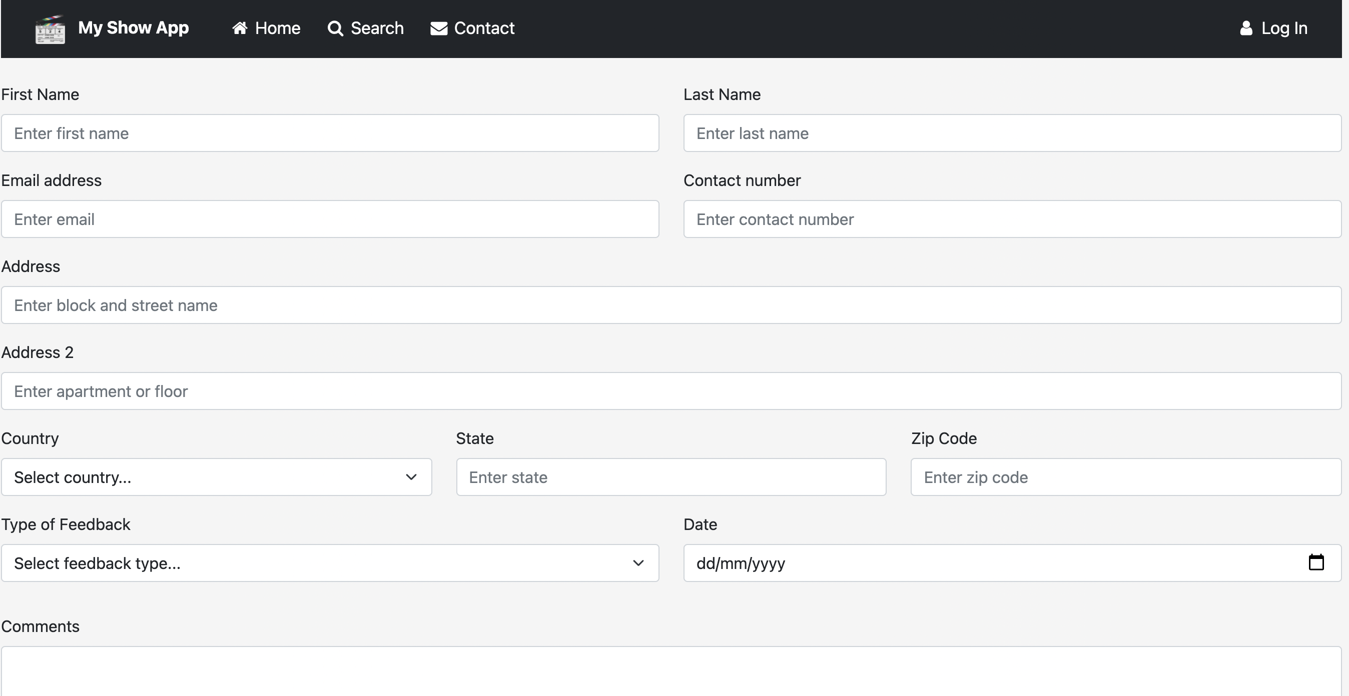
Contact Page

Slide 11
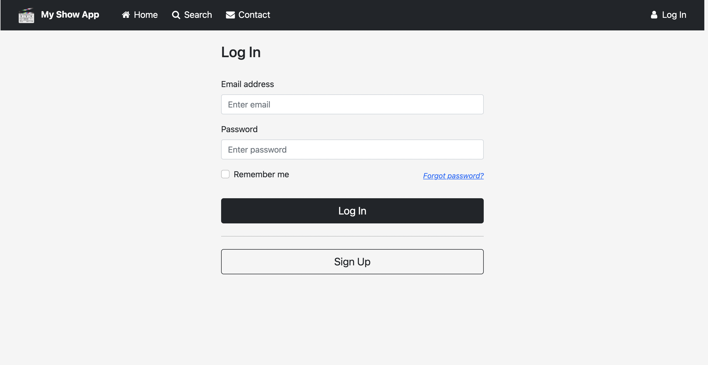
Log In Page

Slide 12
Reflections

Slide 13
Challenges
Cleaning and filtering API data
Pick and choose relevant data for the app (e.g. title, image, synopsis, release date, rating, link to site) (Search, Home.js)
Result type: TV -> modify id to become ‘tv/id’ / Movie -> modify id to include ‘movie/id’ (Search.js, Home.js)
Missing images -> replace with placeholder images (Search.js)
Poster path -> need to combine with another link (Home.js)
Deployment (works on Netlify but not on GitHub Pages?)

Slide 14
Lessons
React-Bootstrap is a life-saver!
NavBar (NavBar.js)
Carousel (Home.js)
Form validation (Contact.js, Login.js) - e.g. Email ‘@‘ sign,
Input, Submit button (Input.js)
Tabs (Search.js)
Badges (Search.js, Favourites.js)

Slide 15
Thank you!

